Slide 1

-By MD ISTYAK
AtliQ Hospitality Analysis

Slide 2
Objective
Atliq Grands owns multiple five-star hotels across India. They have been in the hospitality industry for the past 20 years. Due to strategic moves from other competitors and ineffective decision-making in management, Atliq Grands are losing its market share and revenue in the luxury/business hotels category. As a strategic move, the managing director of Atliq Grands wanted to incorporate “Business and Data Intelligence” in order to regain their market share and revenue. However, they do not have an in-house data analytics team to provide them with these insights.
Their revenue management team had decided to hire a 3rd party service provider to provide them insights from their historical data.

Slide 3
AtliQ
Bangalore
Mumbai
Hyderabad
Delhi
Atliq Bay
Atliq Blu
Atliq City
Atliq Exotica
Atliq Grands
Atliq Palace
Atliq Bay
Atliq Blu
Atliq City
Atliq Exotica
Atliq Grands
Atliq Palace
Atliq Seasons
Atliq Bay
Atliq Blu
Atliq City
Atliq Exotica
Atliq Grands
Atliq Palace
Atliq Bay
Atliq Blu
Atliq City
Atliq Grands
Atliq Palace

Slide 4
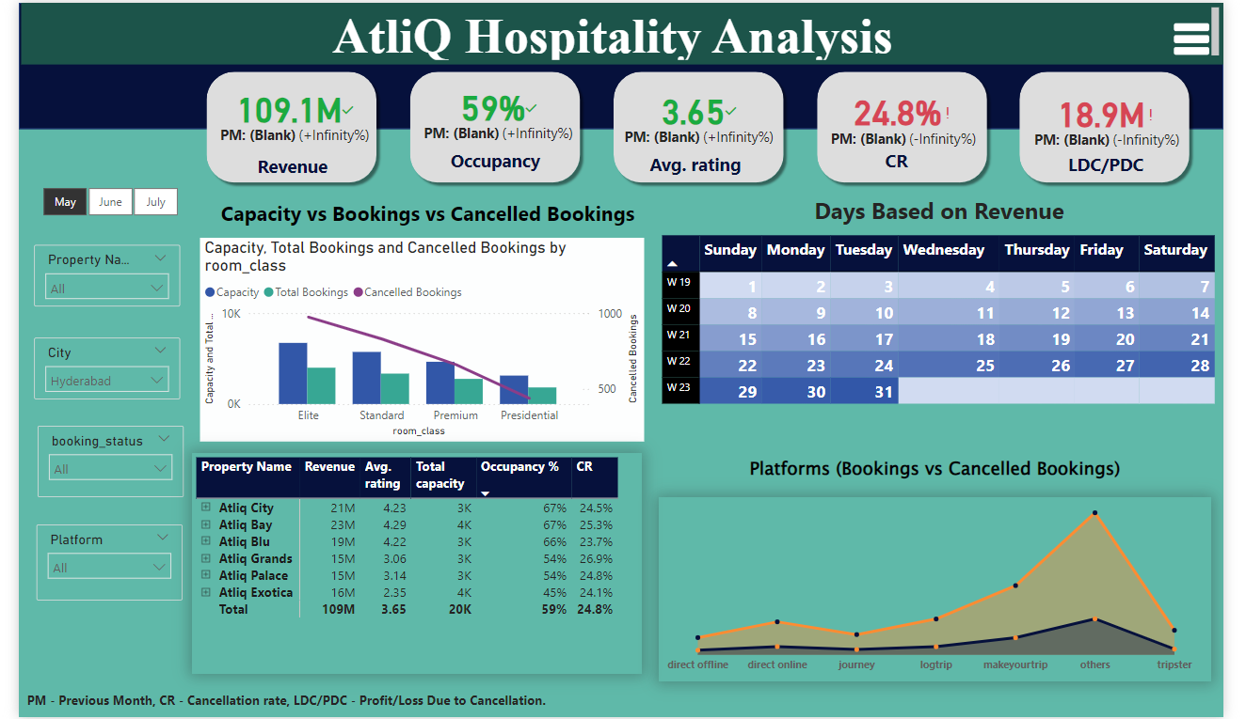
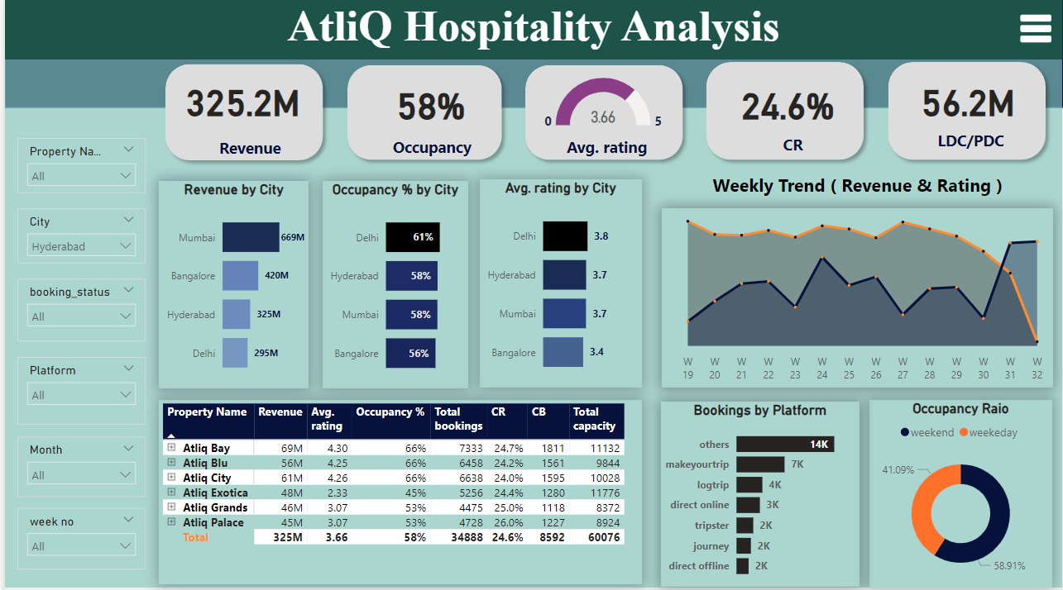
My Design(Dashboard)

Slide 5
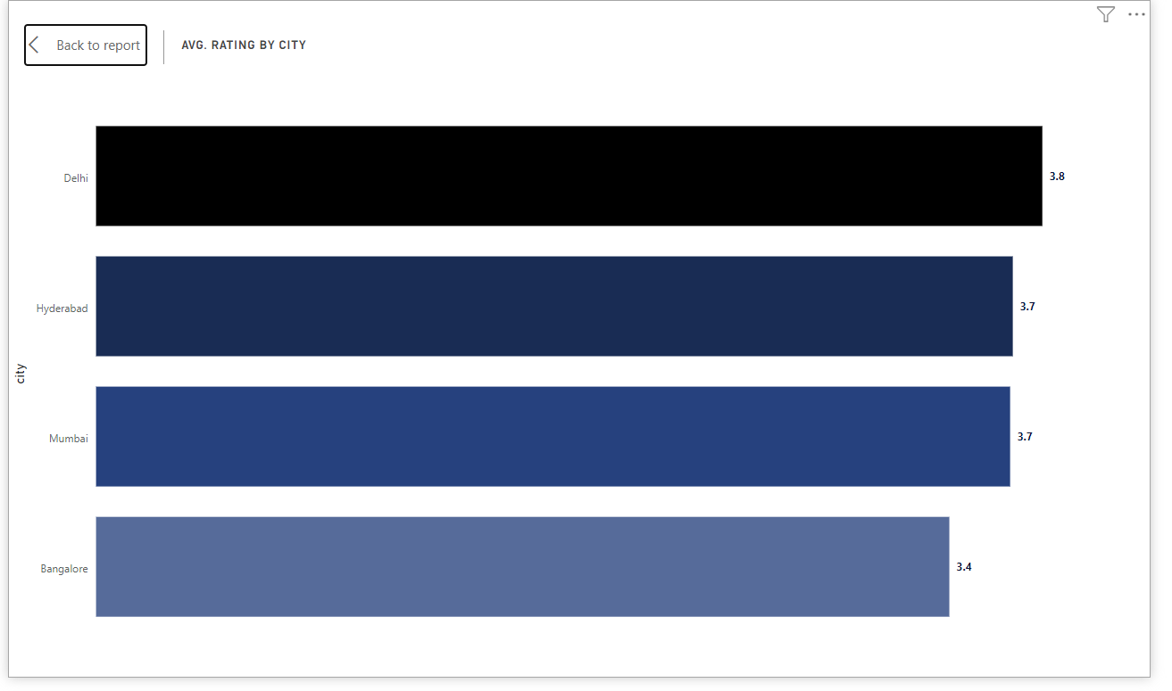
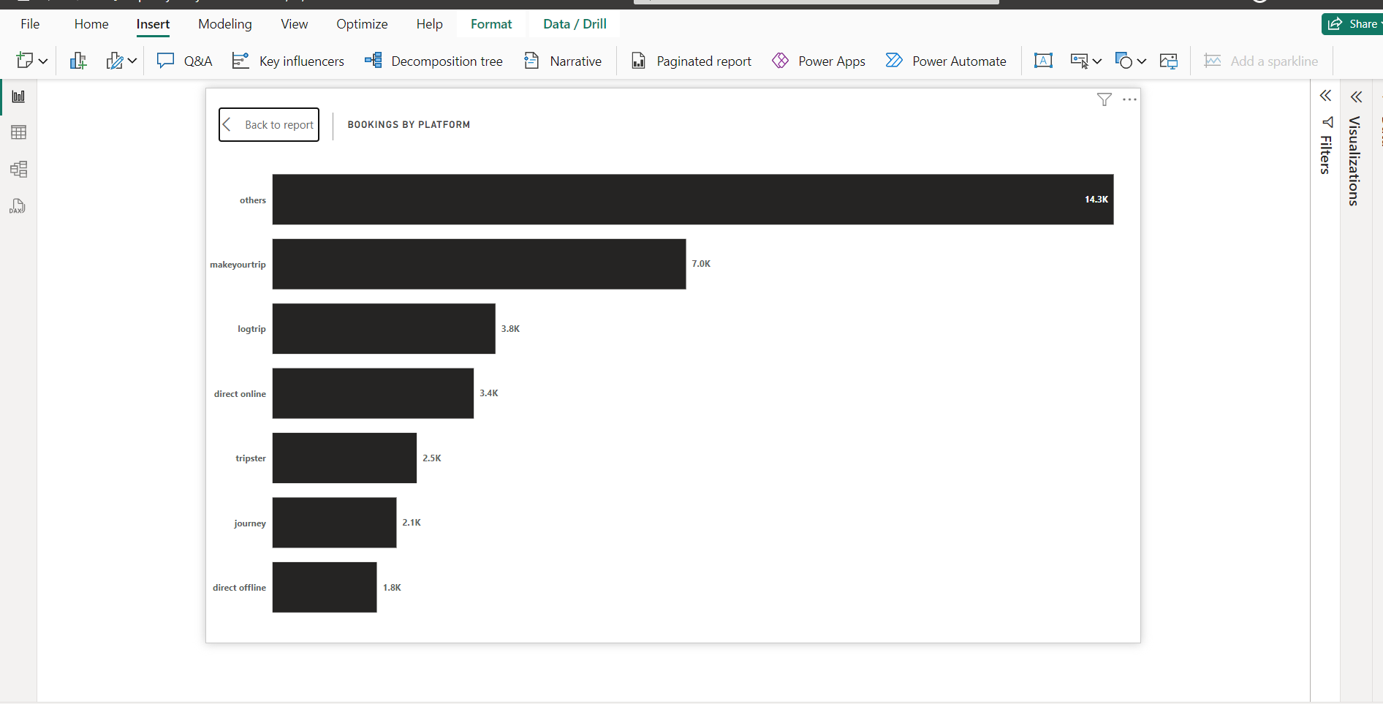
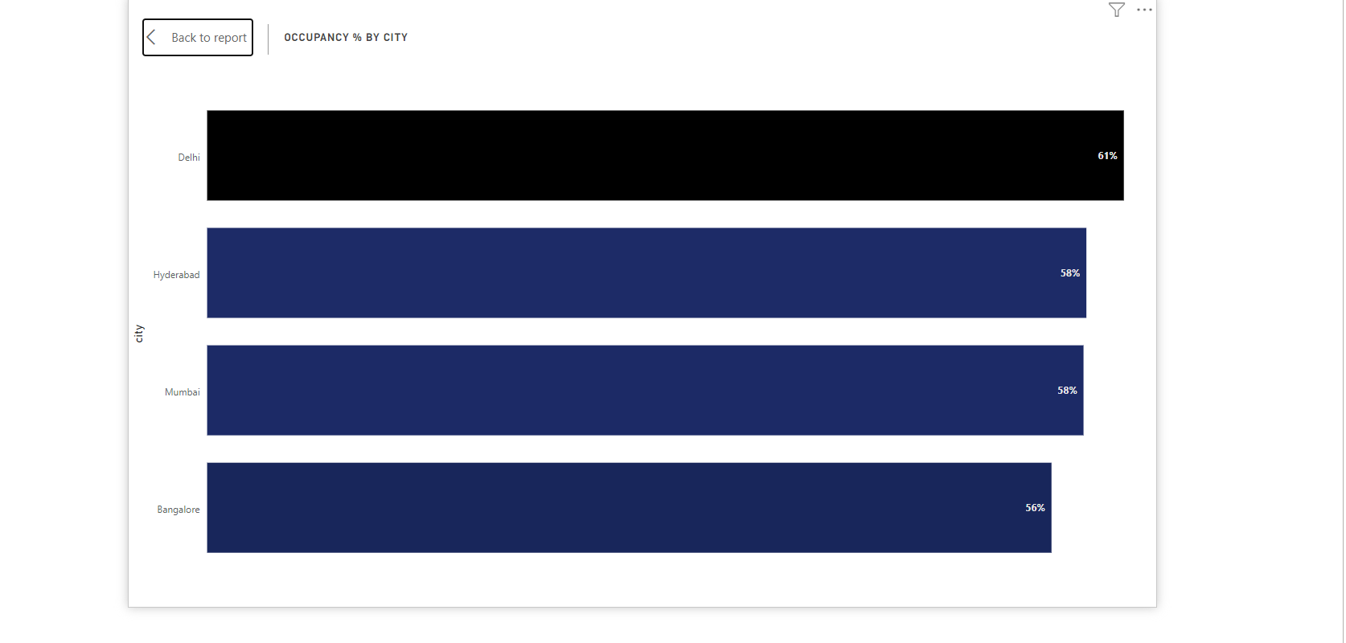
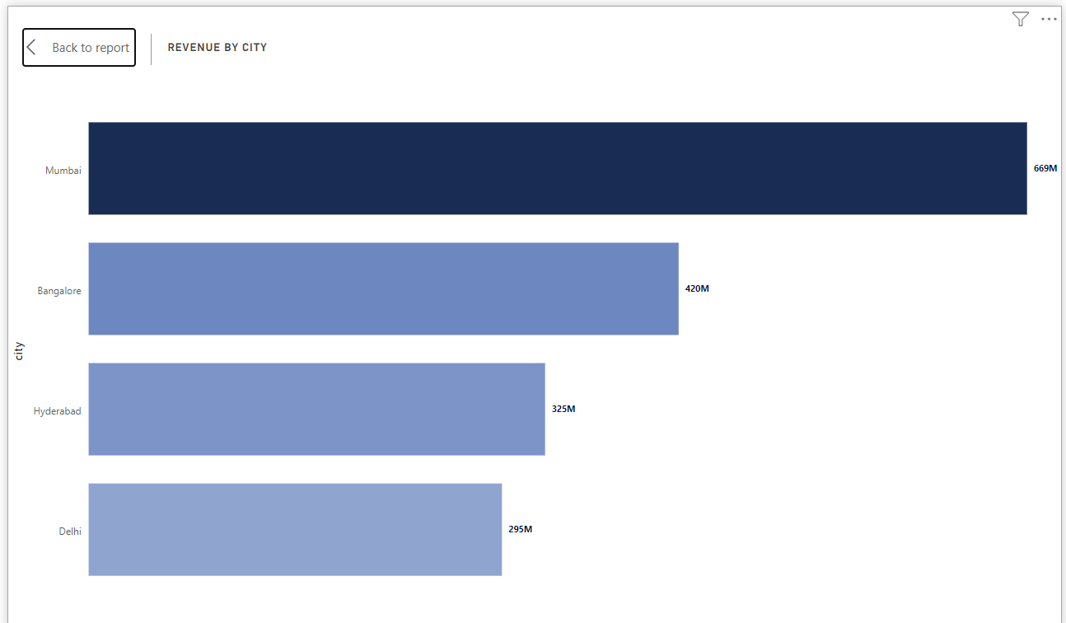
Insights

Slide 6
Conclusion
Mumbai generates the highest revenue (669 M) followed by Bangalore, Hyderabad and Delhi
AtliQ Exotica performs better compared to all 7 type of properties with 320 Million revenue, rating 3.62,
occupancy percentage 57 and cancellation rate as 24.4%.
AtliQ Bay has the highest occupancy of 66%
Week 24 recorded the highest revenue among all, which is 139.6 Million
Delhi tops both in occupancy and rating followed by Hyderabad, Mumbai, Bangalore
AtliQ lost around 298 Million in cancellation
Elite type rooms has the most booking and as well higher cancellation rate

Slide 7
Thank you

